Slide 1
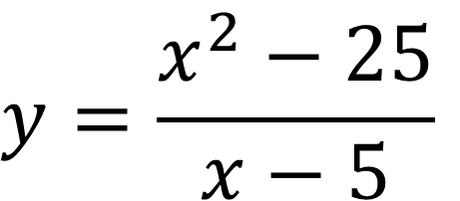
Bell Work
Graph then state the domain, range, x-intercept, y-intercept, vertical and horizontal asymptotes, holes. If an item does not exist, write ‘none’
$$y=\frac{x^{2}−25}{x−5}$$

Slide 2

Follow up question…
$$How would this change if we had:$$
$$y=\frac{x−5}{x^{2}−25}$$

Slide 3
For Last Time…
Page 190 #9-15(odd), 21, 25, 27, 41, 43, 79

Slide 4
Pre-calc trig
Day 18

Slide 5
12.1 Limits an Intro to Calculus
Objective: Use definition of limits to determine if limits exist and evaluate them

Slide 6
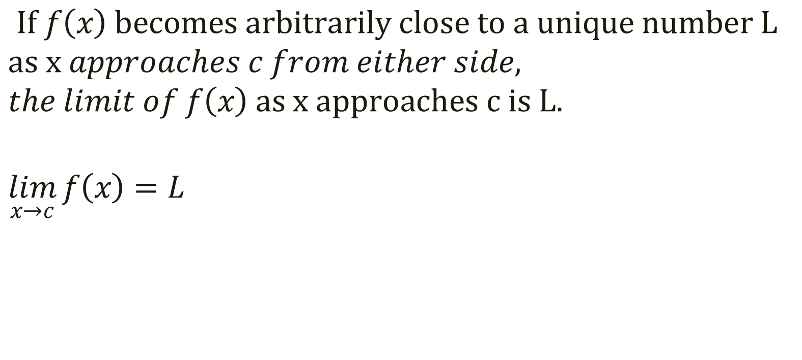
Definition of Limit
$If f\left(x\right) becomes arbitrarily close to a unique number L$
$$as x approaches c from either side,$$
$$the limit of f\left(x\right) as x approaches c is L.$$
$$\lim_{x→c}{f\left(x\right)=L}$$

Slide 7

Estimating a Limit Numerically (whether f(x) at x = c exists or not)
Example 1: $\lim_{x→2}{ (3x−2)}$
x |1.9 1.99 1.999 2.0 2.001 2.01 2.1
f(x) |

Slide 8
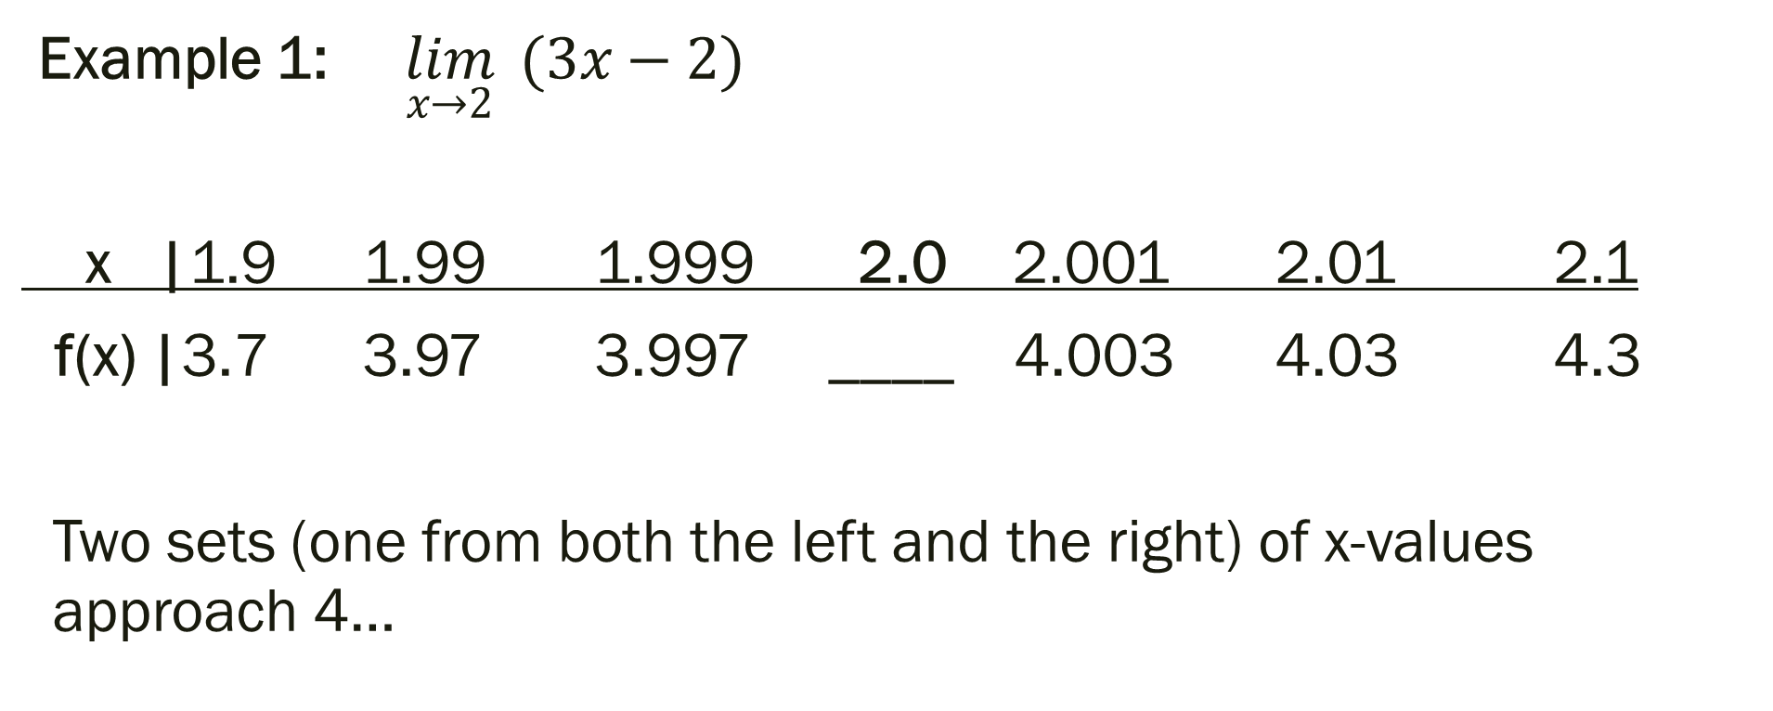
Estimating a Limit Numerically (whether f(x) at x = c exists or not)
Example 1: $\lim_{x→2}{ (3x−2)}$
x |1.9 1.99 1.999 2.0 2.001 2.01 2.1
f(x) |3.7 3.97 3.997 ____ 4.003 4.03 4.3
Two sets (one from both the left and the right) of x-values approach 4…

Slide 9
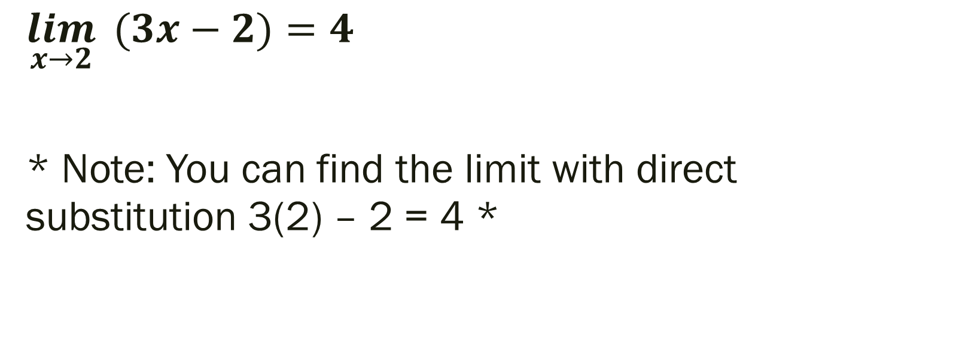
Example 1 Solution:
$$\lim_{x→2}{ (3x−2)}=4$$
* Note: You can find the limit with direct substitution 3(2) – 2 = 4 *

Slide 10

Example 2: $\lim_{x→2}{\frac{x−2}{x^{2}−4}}$
x | 1.9 1.99 1.999 2.0 2.001 2.01 2.1
f(x) |

Slide 11
Example 2: $\lim_{x→2}{\frac{x−2}{x^{2}−4}}$
x | 1.9 1.99 1.999 2.0 2.001 2.01 2.1
f(x) |.2564 .2506 .25006 _____ .2499 .2493 .2439

Slide 12
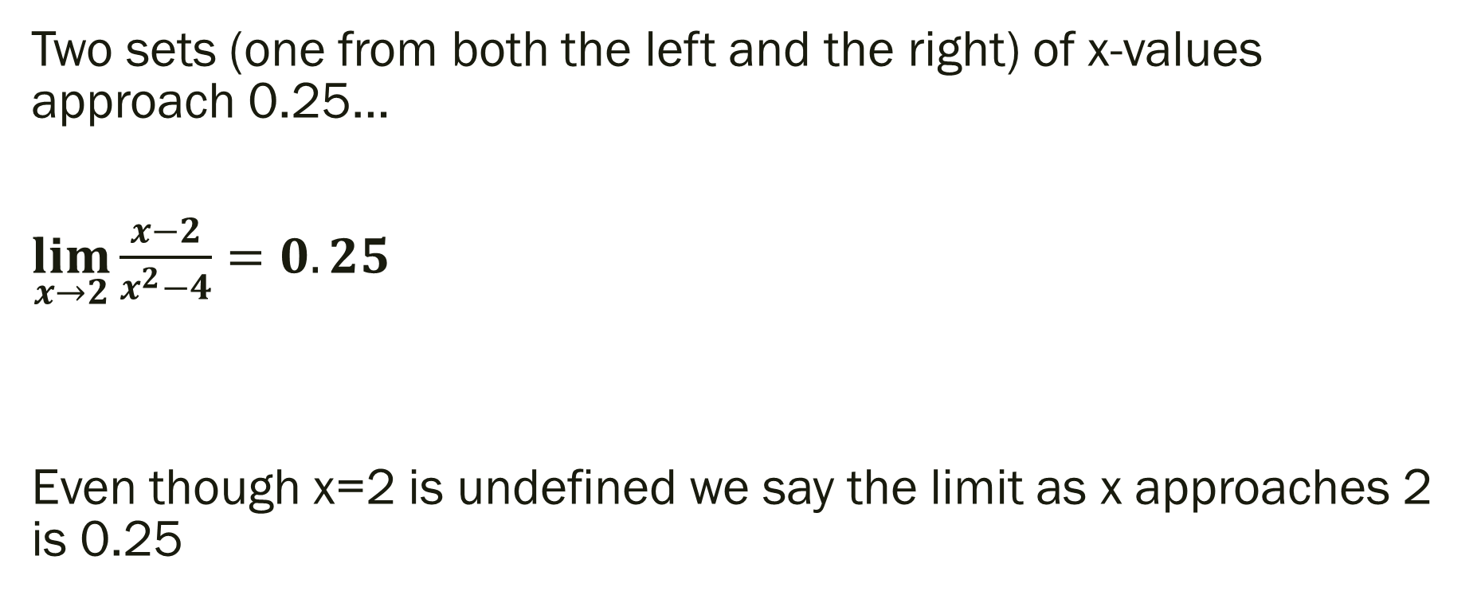
Example 2 Solution
Two sets (one from both the left and the right) of x-values approach 0.25…
$\lim_{x→2}{\frac{x−2}{x^{2}−4}}=0.25$
Even though x=2 is undefined we say the limit as x approaches 2 is 0.25

Slide 13
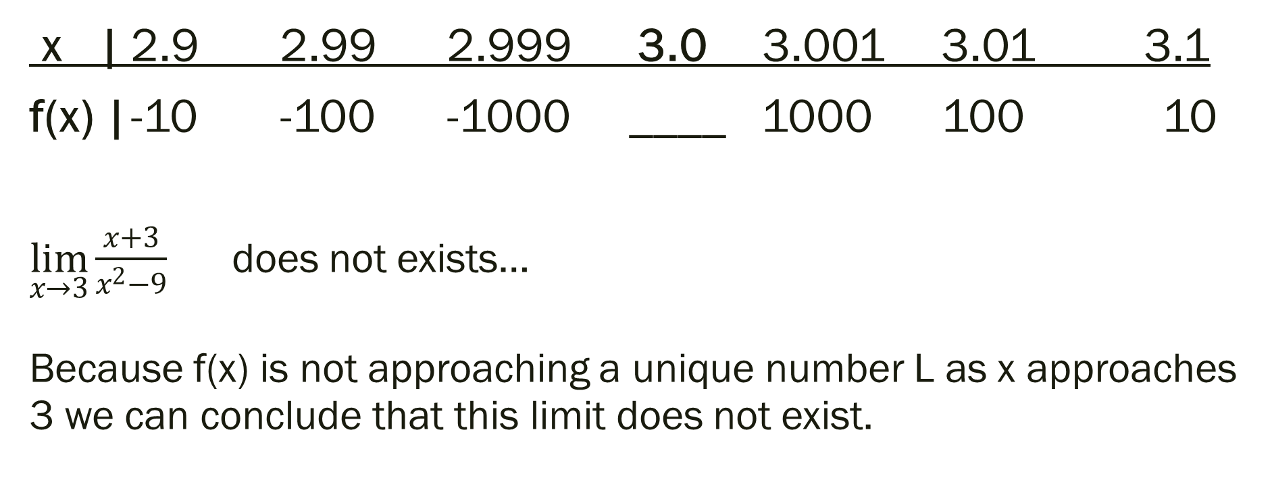

Example 3: $\lim_{x→3}{\frac{x+3}{x^{2}−9}=\frac{x+3}{(x+3)(x−3)}}$
x | 2.9 2.99 2.999 3.0 3.001 3.01 3.1
f(x) | -10 -100 -1000 ____ 1000 100 10
$\lim_{x→3}{\frac{x+3}{x^{2}−9}}$ does not exists… Because f(x) is not approaching a unique number L as x approaches 3 we can conclude that this limit does not exist.

Slide 14
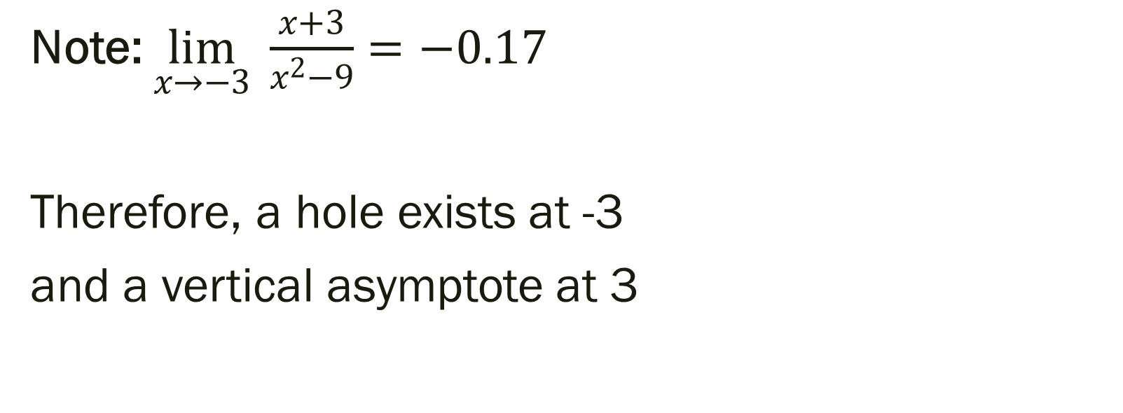
Additional Note on Example 3
Note: $\lim_{x→−3}{ \frac{x+3}{x^{2}−9}}=−0.17$
Therefore, a hole exists at -3
and a vertical asymptote at 3

Slide 15
For next time…
Page 858 #5, 7, 9, 13, 29, 30, 31, 33, 49, 53, 61

